Slide 1
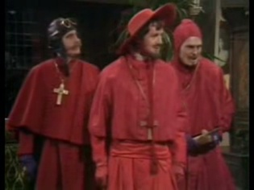
Topic 1
CS314 Course Introduction
Chapman: I didn't expect a kind of Spanish Inquisition.
Cardinal Ximinez: NOBODY expects the Spanish Inquisition! Our chief weapon is surprise...surprise and fear...fear and surprise.... Our two weapons are fear and surprise...and ruthless efficiency.... Our three weapons are fear, surprise, and ruthless efficiency...and an almost fanatical devotion to the Pope.... Our four...no... Amongst our weapons.... Amongst our weaponry...are such diverse elements as fear, surprise....
Mike Scott, Gates 6.304
scottm@cs.utexas.edu
www.cs.utexas.edu/~scottm/cs314/

Slide 2


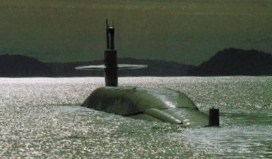
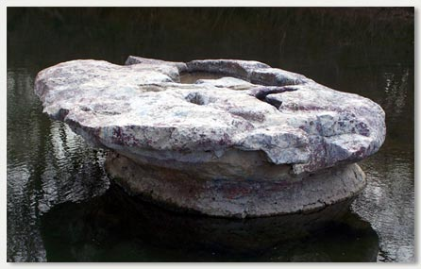
Who Am I?
Lecturer in CS department since 2000
Undergrad Stanford, MSCS RPI
US Navy for 8 years, submarines
2 years Round Rock High School
Wife (Kelly) is a nurse.
  2 daughters, Olivia
  and Isabelle
CS314
Course Overview

Slide 3
What We Will Do Today
Discuss
  course content
  procedures
  tools
For your TO DO list:
  complete items on the startup page
www.cs.utexas.edu/~scottm/cs314/handouts/startup.htm
CS314
Course Overview

Slide 4
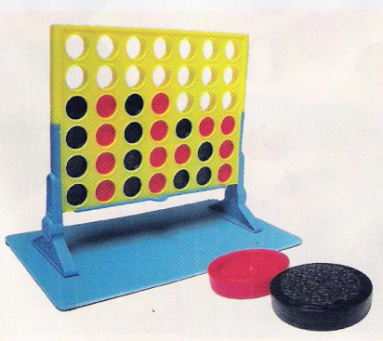
Prerequisites
Formal: CS312 with a grade of C- or higher
Informal: Ability to design and implement programs in Java using the following:
variables and data types
expressions, order of operations
decision making (if statements)
  including boolean logic and boolean expressions
loops (fixed and variable repetition)
procedures or functions
parameters (reference and value parameters, local variables, scope, problem generalization)
structures or records or objects
arrays (vectors, lists)
top down design (breaking big rocks into little rocks)
  algorithm and data design
  create and implement program of at least 200 - 300 loc
  could you write a program to let 2 people play connect 4?
CS314
Course Overview

Slide 5
CS314 Topics
Introduction
Complexity
Encapsulation
Inheritance
Polymorphism
Generics
Interfaces
Iterators
Abstract Classes
Maps, Sets
Linked Lists
Recursion
Recursive Backtracking
Searching, Simple Sorts
Stacks
Queues
Fast Sorting
Trees
Binary Search Trees
Graphs
Hash tables
Red-Black Trees
Heaps
Dynamic Programming
CS314
Course Overview

Slide 6

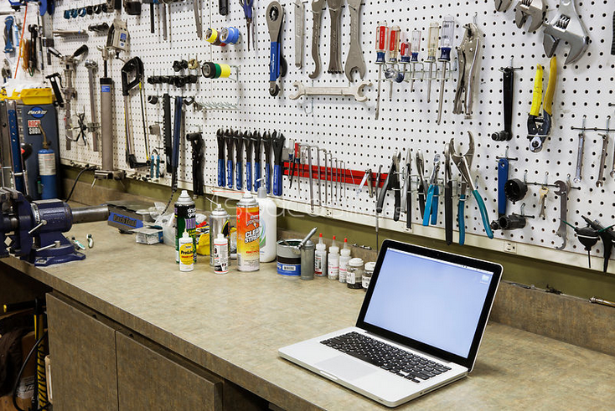
Data Structures
simple definition:
  Variables that store other variables
We will learn a
toolbox full of
data structures
CS314
Course Overview

Slide 7
Clicker Question
Which of the following is a data structure?
a method
a try / catch block
a double
an array
more than one of A - D
CS314
Course Overview

Slide 8
Resources
Class web site – most course material
Schedule – readings
Class discussion group – Piazza
Labs, software (Java, Eclipse, Canvas)
Teaching staff, lab hours
Grades on Canvas
CS314
Course Overview

Slide 9

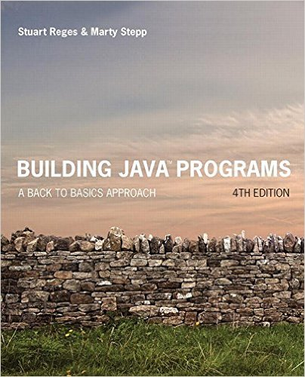

Books and equipment
clicker is required
books are recommended, not required
free alternatives on the web, see schedule
  BJP (CS312 book)
  Thinking Recursively in Java - recursion
CS314
Course Overview
Course Overview

Slide 10
Clicker Question 1
Which of these best describes you?
A. First year at UT and first year college student
B. First year at UT, transferring from another college or university.
C. In second year at UT.
D. In third year at UT
E. Other
CS314
Course Overview

Slide 11
Graded Course Components
clicker participation
  43 lectures with clicker, 1 point each: 43 points total
Discussion section quizzes
  9 quizzes, 10 points each: 90 points total
Programming projects
  11 projects, 20 points each: 220 points total
Exams 2/22 (175 points) and 4/12 (200 points)
  7 - 9 pm
  Final during finals week, TBD: 300 points
43 + 90 + 220 + 175 + 200 + 300 = 1028
clicker, Quizzes, Programming Assignments capped at 325 points.
28 points of “slack” among those 3 components
No points added! Grades based on 1000 points, not 1028
Grades posted to Grade Center on Canvas
CS314
Course Overview

Slide 12
Grades and Performance
Final grade determined by final point total and a 900 – 800 – 700 – 600 scale
  plusses and minuses if within 25 points of cutoff:
  875 – 899: B+, 900 – 924: A-
CS314 Historical Grades - my sections only
71% C- or higher:
  24% A's, 26% B's, 21% C's
14% D or F
15% Q or W (drop)
ON CIS WORK LOAD EVALUATED AS HIGH
CS314
Course Overview

Slide 13
Assignments
Non trivial programming projects
Individual – do your own work
  okay to share tests you write
Programs checked automatically with plagiarism detection software
Turn in the right thing - correct name, correct format or you will lose points / slip days
Slip days
  6 for term, max 2 per assignment
  don’t use frivolously
CS314
Course Overview

Slide 14
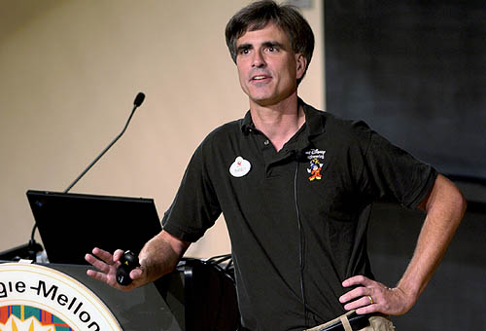
Succeeding in the Course
Randy Pausch,
CS Professor at CMU said:
"When I got tenure a year
early at Virginia, other
Assistant Professors would come up to me and say,
'You got tenure early!?!?! What's your secret?!?!?'
and I would tell them,
'Call me in my office at 10pm on Friday night and I'll tell you.' "
Meaning:
Some things don't have an easy solution.
Some things simply require a lot of hard work.
CS314
Course Overview

Slide 15
Succeeding in the Course
Former student:
  "I really like the boot camp nature of your course."
do the readings
start on assignments early
get help from the teaching staff when you get stuck on an assignment
attend lecture and discussion sections
participate on the class discussion group
do extra problems - http://tinyurl.com/pnzp28f
study for tests using the old tests
study for tests in groups
ask questions and get help when needed
CS314
Course Overview

Slide 16
Course Materials and Procedures
Software
  can work in CS department microlab, 1st or 3rd floor of GDC, Dell hall (north wing)
  login via CS account name and password
  can work at home if you wish
  Java.
    Web page has details under Software. - JDK 8.0
  Optional IDE.
    Recommended IDE is Eclipse, also free
CS314
Course Overview

Slide 17
Clicker Question 2
Which computer programming language are you most comfortable with?
Java
C or C++
C. Python
D. PHP
E. Other
See: http://www.tiobe.com/index.php/content/paperinfo/tpci/index.html
and http://lang-index.sourceforge.net/
CS314
Course Overview

